Slide 1


COMPANY PROFILE
An ISO 9001: 2015 Certified Company

Slide 2






ABC Corporation is the principle company of Advanced ABC Group which has another two principle companies named ABC Biotek & ABC Medical System and other two sister companies named SPAR Industries Ltd. and SPAR Development & Holdings Ltd.

Slide 3

CONTENTS
MANAGEMENT SPEECH
COMPANY OVERVIEW
ABOUT US
ABOUT BANGLADESH
OUR NETWORK
OUR SALES & SERVICE POLICY
MARKET SEGMENT
YEARLY TURNOVER
PRODUCT DEMONSTRATION
MEDICAL EXHIBITION & PRODUCT LAUNCHING
ISO CERTIFICATION CELEBRATION
PRODUCT LAUNCHING CEREMONY
SCIENTIFIC CONFERENCE
SEMINARS
SPONSORINGS OF THE COMPANY
COMMUNAL ACTIVITIES
NEW CONCERNS
OUR TOP CUSTOMERS

Slide 4

Management Speech
“Maintaining trust is more important than ever in the current global business environment. Today ABC Corporation is well recognized as a leading company in the healthcare sector in Bangladesh with their Medical Equipments and Laboratory Reagents. The services of ABC Corporation are made possible in large part by your generous and valuable support.
ABC Corporation Continuously strives to maximize the value that they bring to their customers and stakeholders alike. Efficient and effective operations, optimal logistics and technical expertise all contribute to this effort.
Meanwhile ABC Corporation has expanded their network throughout the country to operate their business chain in a professional, dynamic and socially responsible manner. We are committed to achieve our goal through integrity and sound corporate governance.
The Slogan of ABC Corporation is “WE WANT YOU TO KNOW” & ABC Corporation believes that business profit is the logical consequence of Quality, Services & Commitment.”

Slide 5

COMPANY OVERVIEW
Company Name : ABC Corporation
Certificate : ISO 9001:2015 Certified
Year of Foundation : 2011
Headquarter : Navana Zohura Square
3rd Floor, 28 Kazi Nazrul Islam Avenue,
Banglamotor, Dhaka, Bangladesh.
Number of Employee : 230
Number of Branch : 45
Range of Business : Medical Equipment
Telephone : +88-0255-168065
Fax : +88-0291-35770
E-mail : info@abc-bd.com
Web : www.advancedabcgroup.com
ABC Technical Service : +88-01730795195
Product Orders : +88-01730795222

Slide 6

ABOUT US
ABC Corporation, Bangladesh (ESTD.2011) is an ISO 9001:2015 certified & a leading medical device importer & distributor company in the sector of IVD (In-Vitro Diagnostic) at healthcare in Bangladesh which is focused on IVD instruments, Reagents, Quality Controls and then consumables, and disposables etc. for different manufacturer’s product categories. We have more than 10,000 medical device installations experience, a sales network of 45 branch office at different cities in the country, more than 100 sales people, 80+ service engineers, 200 sub dealers with a wide range of medical products. We made revolution in the IVD sector by introducing new technology, methods, special tests, high quality and fully automation system which is using first world countries.

Slide 7

OUR VISION AND MISSION
“Our vision is to improve Diagnostic Sector of Bangladesh by Providing cost Effective & Innovative Products and Services”.
Inspiring by our vision, Our Mission is to retain our leading position in the field of In Vitro Diagnostic (IVD) sector in Bangladesh. We want to spread our service to each and every kind of laboratories of IVD sector all over the country and ensure at least one unit of our analyzer must be installed in any of the laboratory within the near future, although we have already installed about 10,000 analyzers so far.

Slide 8
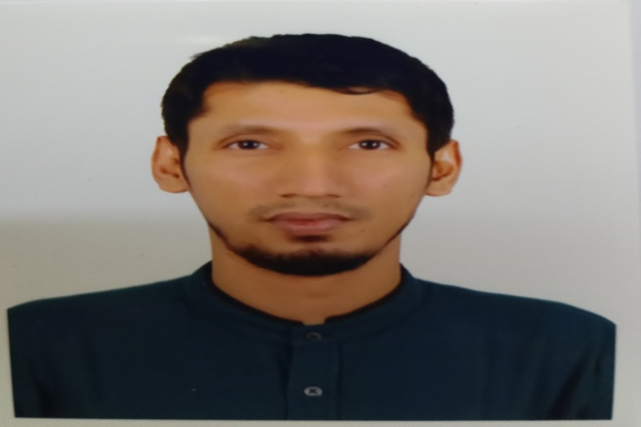
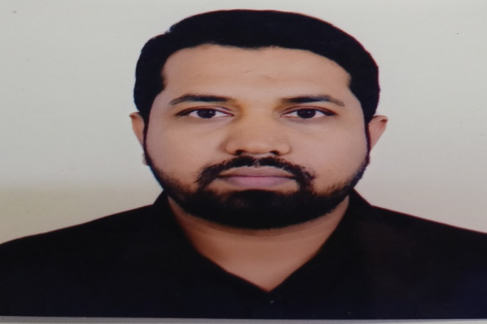
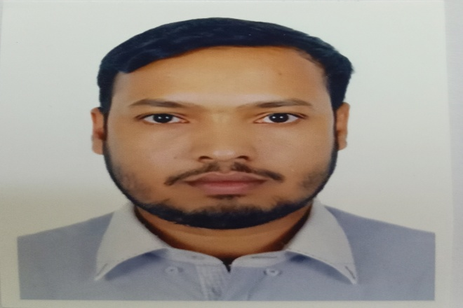
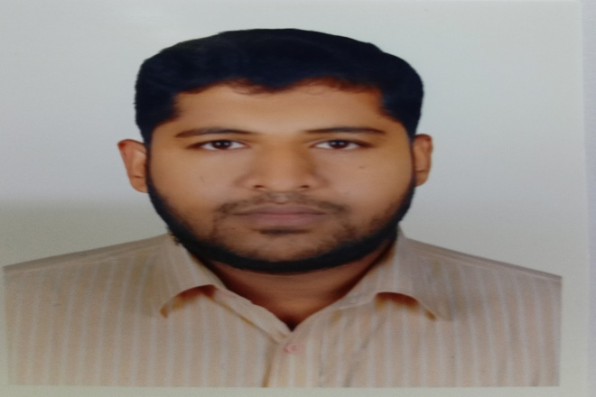
COMPANY MANAGEMENT
It is our pleasure to introduce our Management team as:
Engr. Md. Shahriar Shourave
Group Managing Director
Engr. Md. Mosarof Hosan Executive Director
Engr. Md. Anwar Hossain Director (Sales & Marketing)
Engr. Parikshit Basak Technical Director

Slide 9
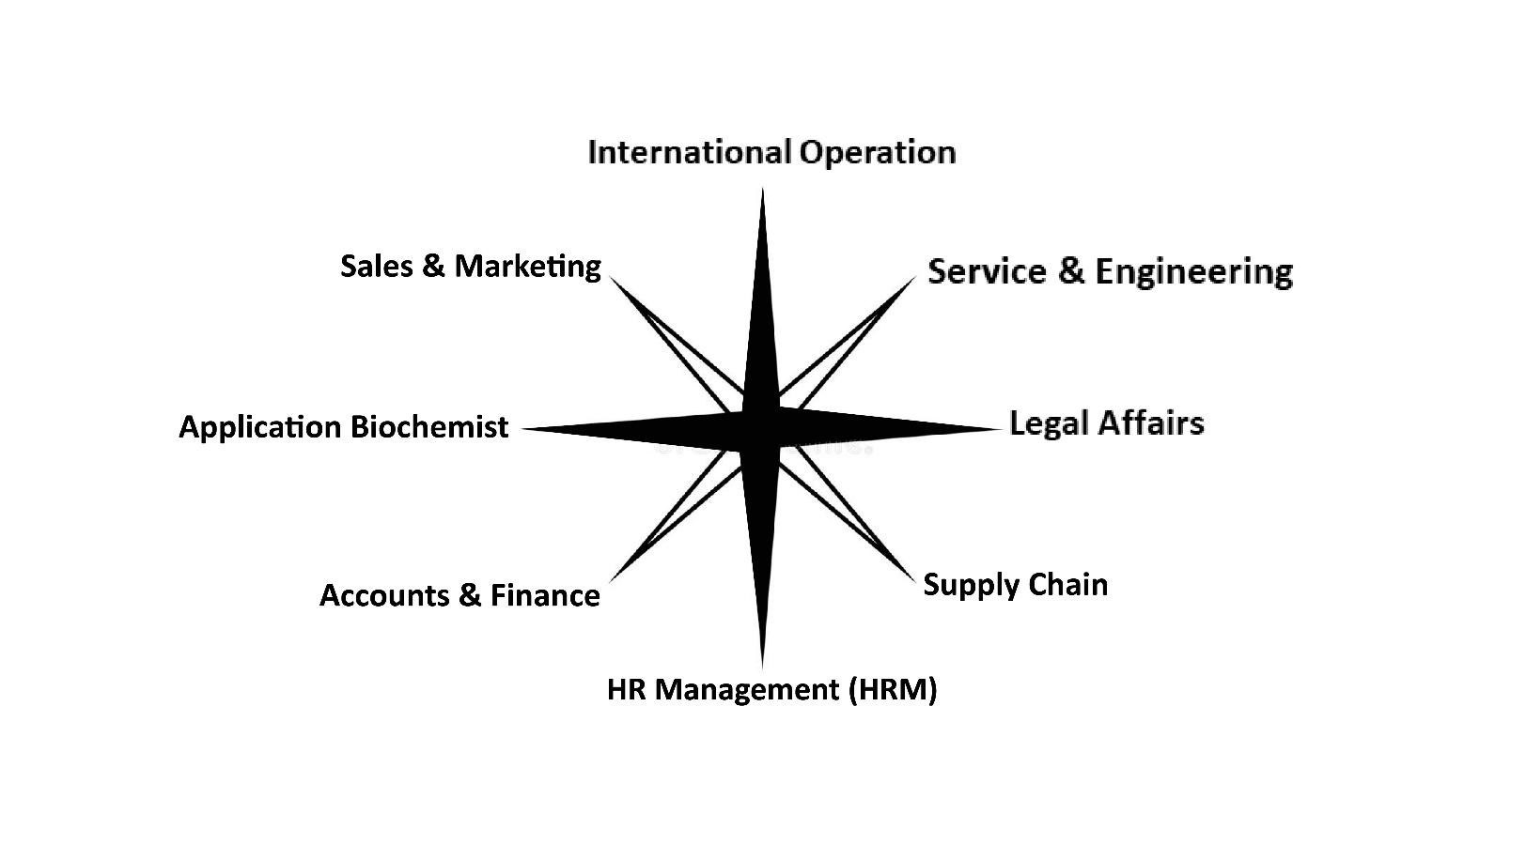
Team ABC Corporation
The total number of employees in our company is about 230 including headquarter and other branches in Bangladesh. Among them the total number of Sales officers are 100, Service Engineers are 80+ and others in house office management. All of our employees are very dedicated, well trained, young, energetic and professional.

Slide 10


ABOUT BANGLADESH
Total Population: 167821313
Male/Female ratio: 50.6/49.4
Registered Healthcare Organization:26500
GDP: 400.00 USD Billion
Total area: 147,610 SQ.KM
Notes:
https://www.worldometers.info/world-population/bangladesh-population/

Slide 11
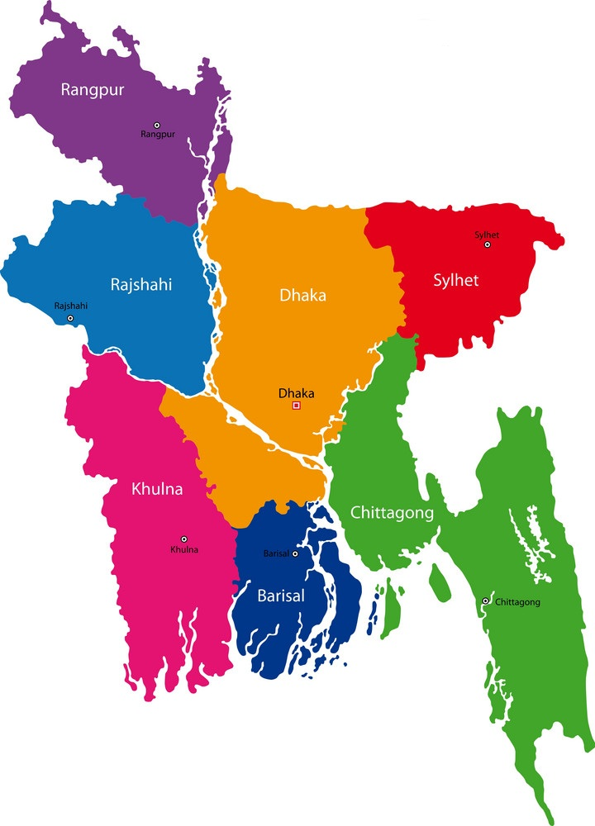



OUR NETWORK

Slide 12
OUR NETWORK
Chattogram Office
Sylhet Office
Uttara Office
Rajshahi Office
Mymensingh Office
Barishal Office
Rangpur Office
Khulna Office
Cumilla Office
Gazipur Office
Faridpur Office
Noakhali Office
Bagura Office
Pabna Office
Sirajganj Office
Jashore Office
B.Baria Office
Kushtia Office
Sherpur Office
Jamalpur Office
Feni Office
Dinajpur Office
Magura Office
Nilphamari Office
Tangail Office
Kishoreganj Office
Gopalganj Office
Chuadanga Office
Habiganj Office
Narsingdi Office
Cox’s Bazar Office
Narayanganj Office
Munshiganj Office
Bhola Office
Rajbari Office
Manikganj Office

Slide 13

OUR SALES POLICY
Our Well trained Sales Executives are strongly determined to highlight our product profile to the existing and potential customers maintaining proper schedule. There are two types of marketing policies to provide closed system machines. One is by selling machine and another one is Reagent Agreement Plan (RAP) - where we invest machine and user only purchase reagents according to their requirements as per agreement. We only go for RAP while the number of sample volumes rise to the good level. We cherish the sense to spread our network even at the remote area of the country.

Slide 14

OUR SERVICE SUPPORT
We have a strong service oriented team that are fully dedicated and consistently responsive to serve our customers for 365/24/7. Our service is full free of charge and after call we reach our customers within 2 hours. More than 25 of our engineers are foreign trained. Even they get trained up by the foreign technical persons in house every year for each product. Our application team is also foreign trained.

Slide 15

MARKET SEGMENT

Slide 16
YEARLY TURNOVER
TURNOVER (Million $USD)

Slide 17




















WE REPRESENT

Slide 18

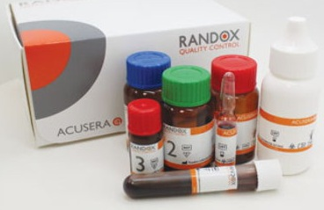
Third Party Quality Control
Company Name: Randox Laboratories Inc.
Origin: UK
Concerned Products: IQC, RIQAS, 24*7

Slide 19
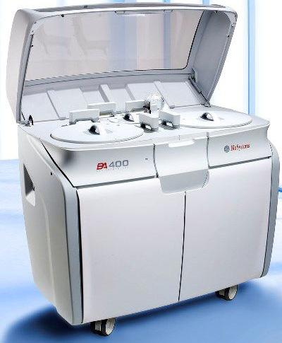
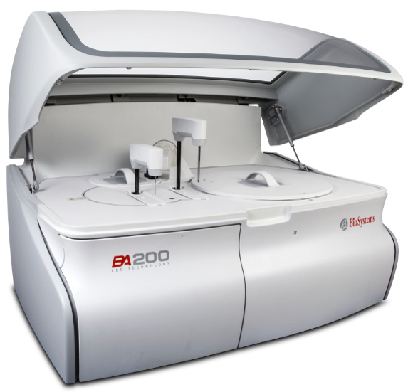
Company Name: BioSystems S.A.
Origin: Spain
Concerned Products: Automated Biochemistry Analyzer
BA-200 BA-400

Slide 20
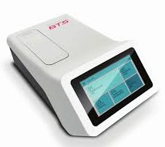
Company Name: BioSystems S.A.
Origin: Spain
Concerned Products: Automated Biochemistry Analyzer
BTS

Slide 21
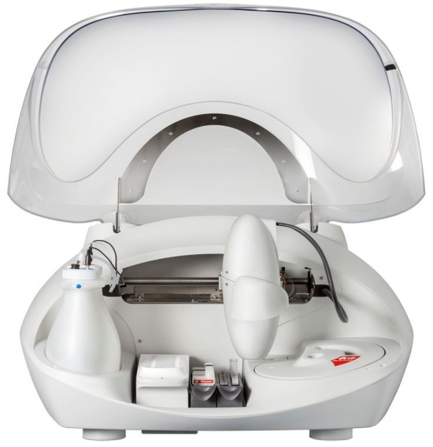
Company Name: BioSystems S.A.
Origin: Spain
Concerned Products: Fully Automated Stool Analyzer
A-15

Slide 22

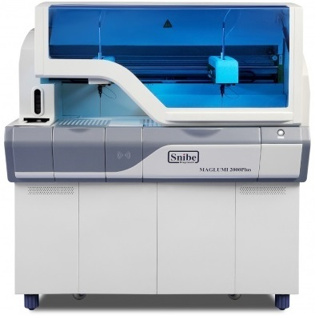
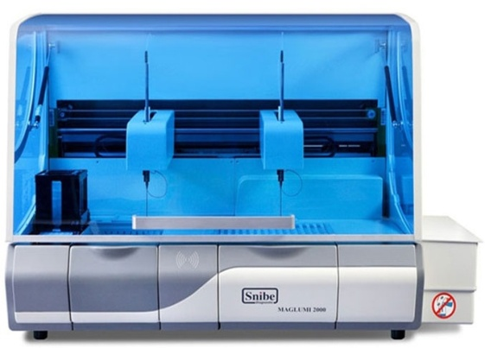
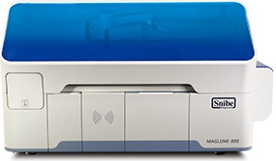
Maglumi-800 Maglumi-2000 Maglumi-2000Plus
Company Name: Shenzhen New Industries Biomedical Engineering Co., Ltd.(SNIBE)
Origin: China
Concerned Products: Automated Chemiluminescence Immunoassay System (CLIA)

Slide 23
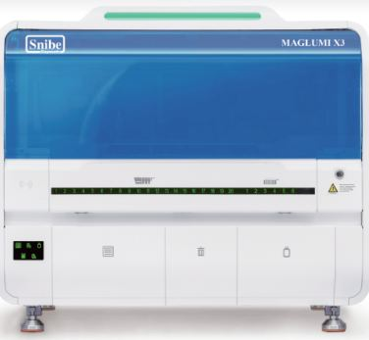
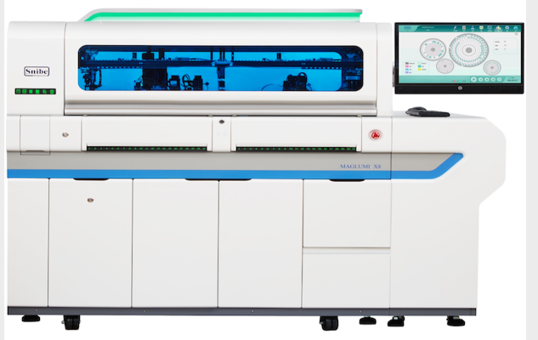
Company Name: Shenzhen New Industries Biomedical Engineering Co., Ltd.(SNIBE)
Origin: China
Concerned Products: Automated Chemiluminescence Immunoassay System (CLIA)
Maglumi-X3 Maglumi-X8

Slide 24
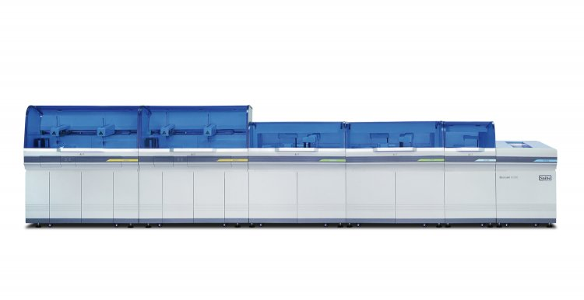
Biolumi -8000
Company Name: Shenzhen New Industries Biomedical Engineering Co., Ltd.(SNIBE)
Origin: China
Concerned Products: SNIBE Integrated System.

Slide 25

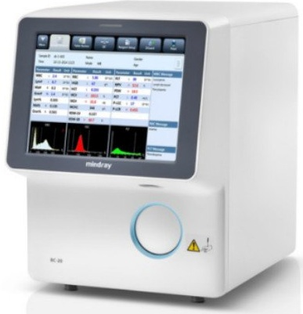
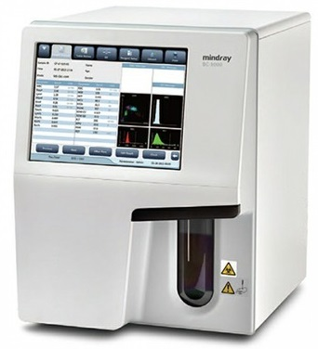
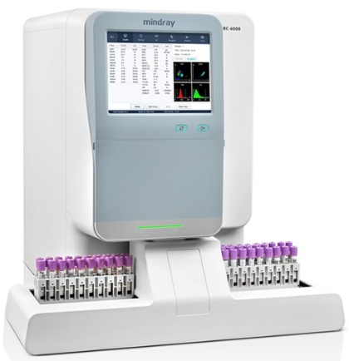
BC -20 BC-5000 BC-6000
Company Name: Shenzhen Mindray Bio-Medical Electronics Co., Ltd.
Origin: China
Concerned Products: Fully Automated Hematology Analyzer

Slide 26

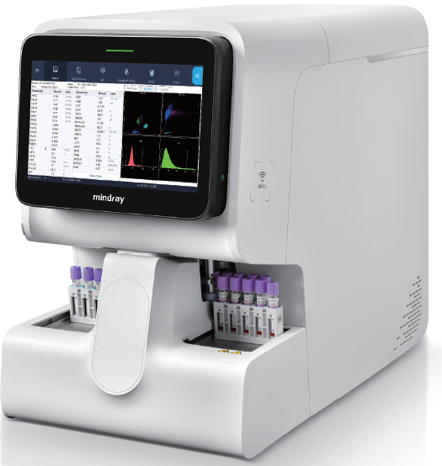
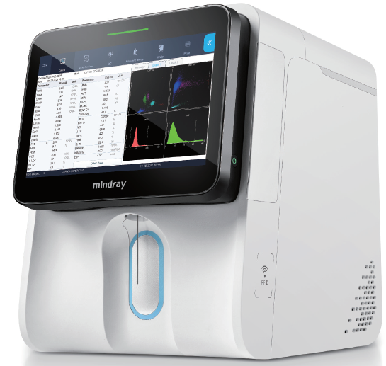
Company Name: Shenzhen Mindray Bio-Medical Electronics Co., Ltd.
Origin: China
Concerned Products: Fully Automated Hematology Analyzer with ESR
BC- 760 & BC-780 BC-700 & BC-720

Slide 27
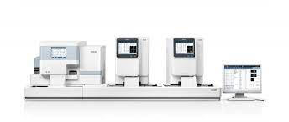
Company Name: Shenzhen Mindray Bio-Medical Electronics Co., Ltd.
Origin: China
Concerned Products: Fully Automated Hematology Analyzer with Slide Maker
CAL - 6000

Slide 28
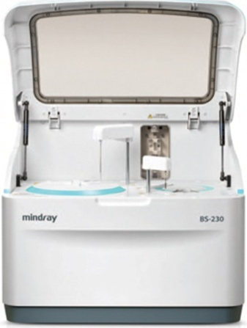
BS- 230/240
Company Name: Shenzhen Mindray Bio-Medical Electronics Co., Ltd.
Origin: China
Concerned Products: Fully Automated Biochemistry Analyzer

Slide 29
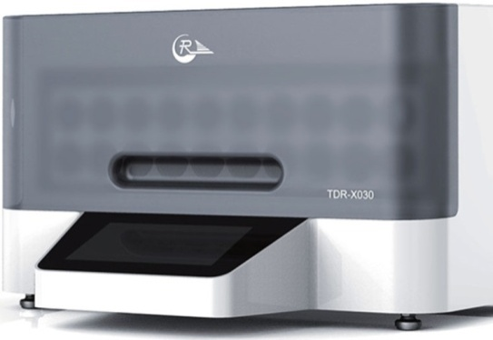
TDR – X030
Company Name: Shenzhen Mindray Bio-Medical Electronics Co., Ltd.
Origin: China
Concerned Products: Automated Blood Culture System

Slide 30

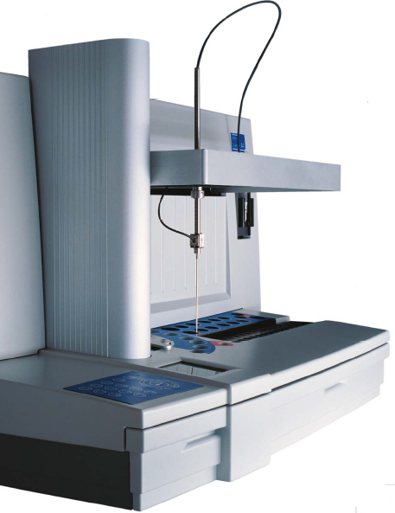
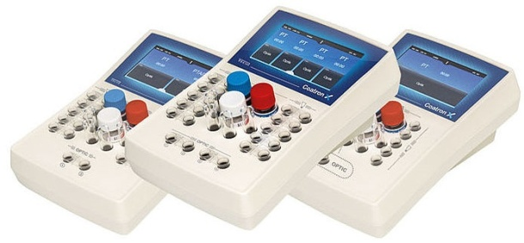
Coatron- X Coatron- A4
Company Name: TECO Medical Instruments
Origin: Germany
Concerned Products: Coagulation Analyzer

Slide 31

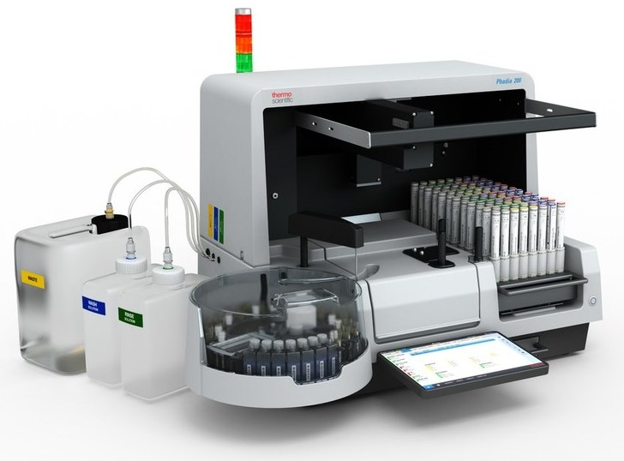
Company Name: Thermo Fisher Scientific Pvt. Ltd.
Company Origin: USA
Instrument Origin: Sweden
Concerned Products: Automated Allergy and Autoimmuno Disease Testing System
Phadia 200

Slide 32

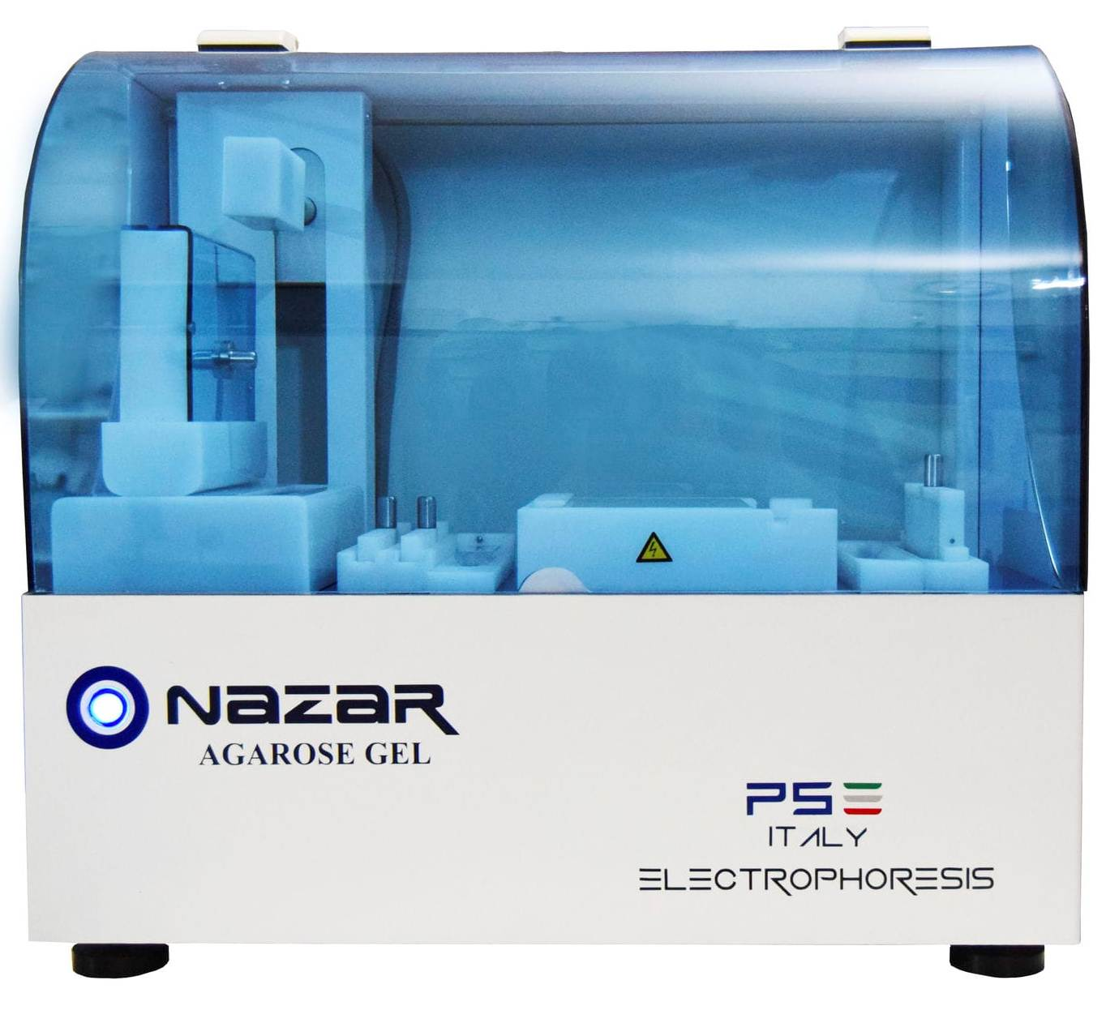
Company Name: P.S. Elettronica
Company Origin: Italy
Concerned Products: Fully Automatic Electrophoresis Instrument (Agarose Gel)
NAZAR

Slide 33

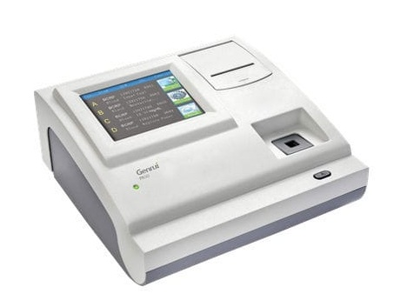
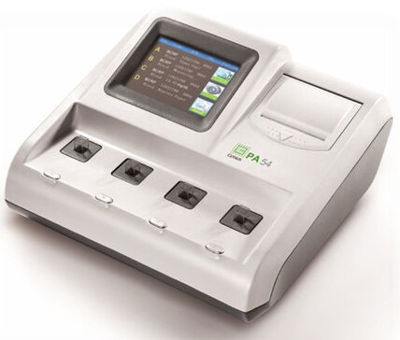
PA -50 PA-54
Company Name: Genrui Inc.
Origin: China
Concerned Products: Specific Protein Analyzer

Slide 34
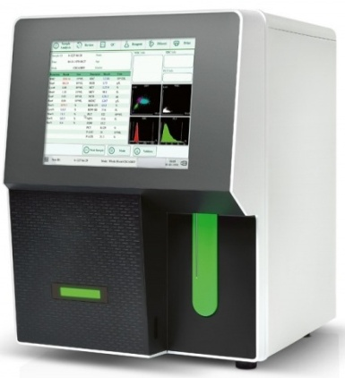
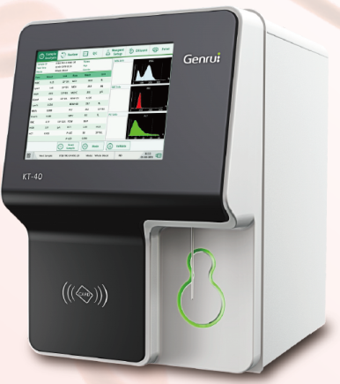
KT-40 KT-6600
Company Name : Genrui Inc.
Origin: China
Concerned Products: Automated Hematology Analyzer

Slide 35

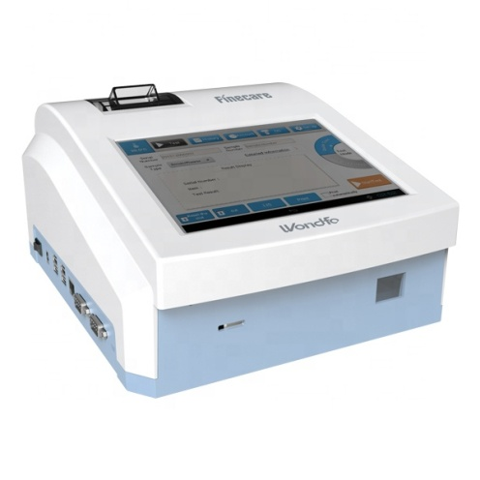
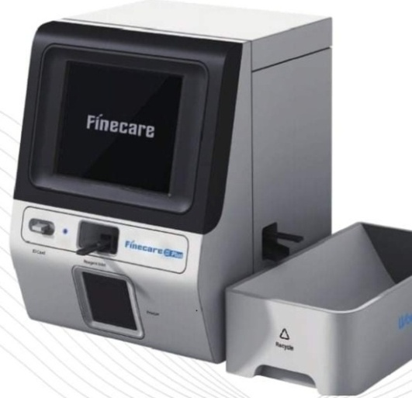
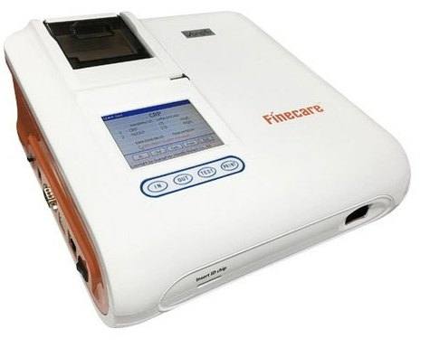
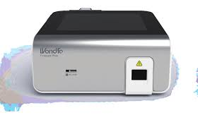
FS-112 FS-113 FS-114 FS-205
Company Name: Guangzhou Wondfo Biotech Co., Ltd.
Origin: China
Concerned Products: Immuno Fluorescent Test System (POCT Analyzer)

Slide 36

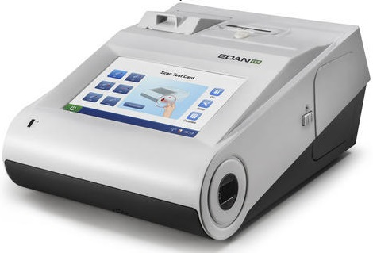
i-15
Company Name: EDAN Instruments Inc.
Origin: China
Concerned Products: Automated Blood Gas Analyzer

Slide 37

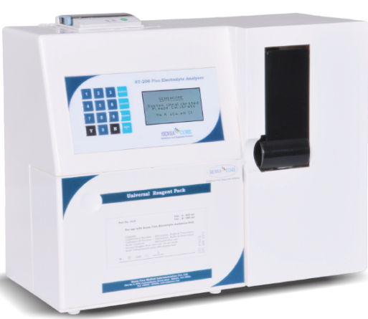
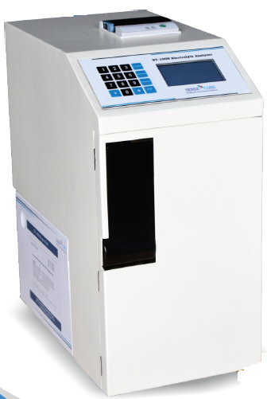
ST-200 Plus ST-100B
Company Name: Sensa Core Medical Instrumentation Pvt. Ltd.
Technology and R&D: USA
Assembling Plant: India
Concerned Products: Electrolyte Analyzer

Slide 38

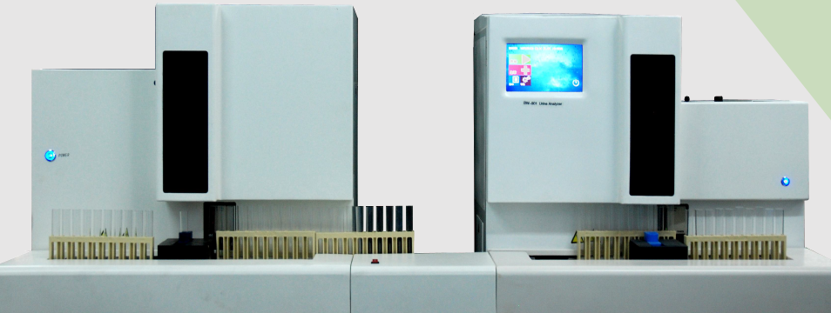
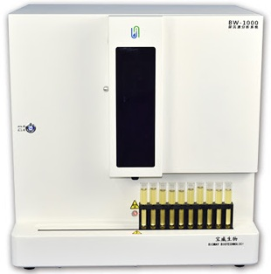
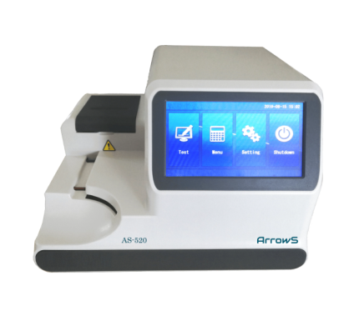
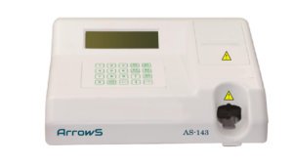
BW- 3000 + BW- 901
Company Name: BIOWAY BIOLOGICAL TECHNOLOGY CO., LTD.
Origin: China
Concerned Products: Fully Automated Urine Analyzer & Semi Automatic Urine Analyzer.
BW- 1000 + BW- 300
BW- 200

Slide 39

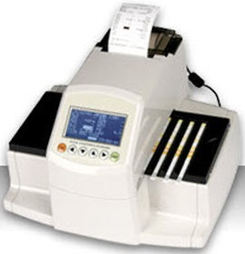
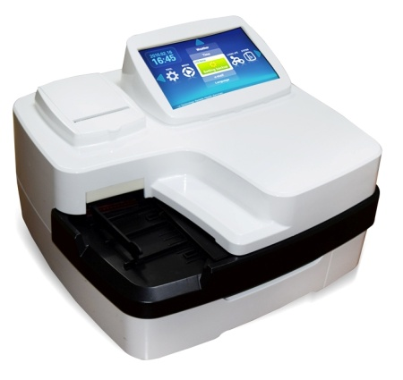
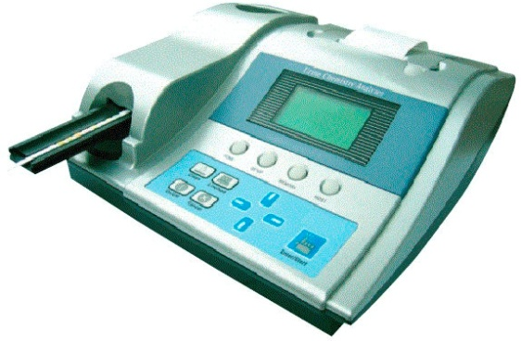
CYBOW R-50 CYBOW R-300 CYBOW R-600S
Company Name: DFI Co., Ltd.
Origin: South Korea
Concerned Products: Urine Chemistry Analyzer and Strips.

Slide 40

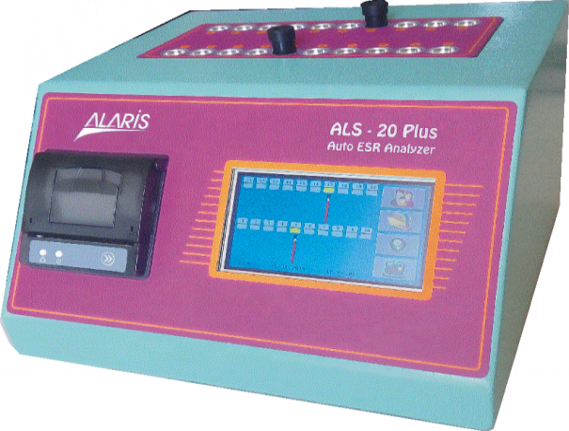
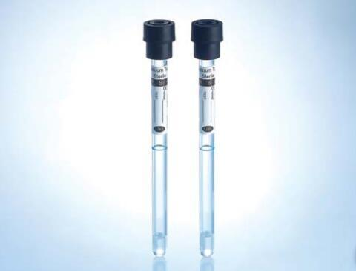
ALS-20 Plus Vacuum ESR Tube
Company Name: Alaris MEDiKAL ve ElEKTRONiK SiSTEMLER SAN. TiC.
Origin: Turkey
Concerned Products: Automated ESR Analyzer and Vacuum ESR Tube.

Slide 41

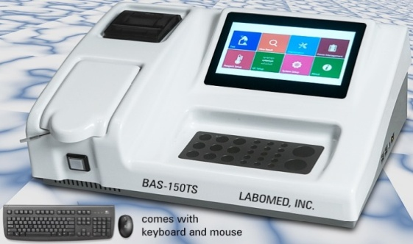

BAS-150TS EMR-600
Company Name: Labomed Inc.
Origin: USA
Concerned Products: Semi Auto Biochemistry Analyzer and ELISA Reader

Slide 42


Clinical Chemistry Reagents
Company Name: Egy Chem Lab Technology
Origin: Egypt
Concerned Products: Clinical Chemistry Reagents.

Slide 43




Company Name: Bio-Hisure
Origin: China
Brand: Zeedo
Automatic Tissue Processor
Semi Automatic Microtome
Fully Automatic Cryostat Microtome

Slide 44




Company Name: Bio-Hisure
Origin: China
Brand: Zeedo
Automatic Slide Stainer
Fully Immuno Auto Stainer
Tissue Embedding System
Spin Tissue Processor (Vacuum)

Slide 45




Company Name: Bio-Hisure
Origin: China
Brand: Zeedo
Tissue Floating Water Bath
Tissue Embedding System
Slide Storage Cabinet
Tissue Water Bath
Slide Storage Cabinet

Slide 46

Surgical Division
REPRESENTS
OTC Division

Slide 47

Company Name: Bionime Corporation
Origin: Taiwan
Concerned Products: Blood Glucose Monitoring System
Distributed by: ABC Biotek (OTC Division)
* ISO Certified
* CE Marked
* US FDA Approved
GE Max

Slide 48


Company Name: Cofoe Medical Technology Co., Ltd.
Origin: China
Concerned Products: Blood Glucose Monitoring System
Distributed by: ABC Biotek (OTC Division)
KF- A03-C/ KF-A10-C

Slide 49


Company Name: Asturias International Pte. Ltd.
Origin: Singapore
Concerned Products: Blood Pressure Monitoring System
Distributed by: ABC Biotek (OTC Division)
SG-MAX

Slide 50

Company Name: Cofoe Medical Technology Co., Ltd.
Origin: China
Concerned Products: Blood Pressure Monitoring System
Distributed by: ABC Biotek (OTC Division)
KF-65A

Slide 51


Company Name: Lotus Surgicals Pvt.Ltd.
Origin: India
Concerned Products: Absorbable and Non-absorbable, Braided and Monofilament
Sutures, Surgical Mesh, Clips and Appliers, Surgical Staplers, Surgical kits
Distributed by: ABC Biotek (Surgical Division)

Slide 52


Disposable Hand Gloves
Distributed by: ABC Biotek (Surgical Division)

Slide 53
REPRESENTS
Imaging Division
Medical Division

Slide 54





Company Name: CHISON Medical Technologies Co., Ltd.
Origin: China
Concerned Products: 4D Color Doppler Ultrasound
Distributed by: ABC Medical System (Imaging Division)
Model: QBIT-5
Model: CBIT-4
Model: CBIT-8
Model: XBIT-80

Slide 55


Company Name: EDAN Instruments Inc.
Origin: China
Concerned Products: Patient Monitor
Distributed by: ABC Medical System (Imaging Division)
Model: Elite V5

Slide 56


Company Name: EDAN Instruments Inc.
Origin: China
Concerned Products: Electrocardiograph (ECG) Machine
Distributed by: ABC Medical System (Imaging Division)
Model: SE-601 (6-Channels)
Model: SE-1200 (12-Channels)

Slide 57




MEDICAL EXHIBITION
13th MEDITEX-2022 AT INTERNATIONAL CONVENTION CITY BASHUNDHARA (ICCB)

Slide 58




MEDICAL EXHIBITION
MEDITEX-2015 AT BICC MEDITEX-2016 AT BICC
MEDITEX-2017 AT BASHUNDHARA CONVENTION CENTER MEDITEX -2022 AT MOMO INN BOGURA

Slide 59




GRAND CELEBRATION
ON ISO 9001:2015 CERTIFICATION

Slide 60





PRODUCT LAUNCHING CEREMONY

Slide 61




SCIENTIFIC CONFERENCE
SCIENTIFIC CONFERENCE ON SNIBE AT BICC
SCIENTIFIC WORKSHOP ON QC MANAGEMENT AT BSMMU
SCIENTIFIC SEMINAR ON RANDOX IN SYLHET DIVISION

Slide 62




SEMINARS
SCIENTIFIC SEMINAR IN RAJSHAHI
SCIENTIFIC SEMINAR IN FENI
SCIENTIFIC SEMINAR IN KHULNA

Slide 63




PROGRAMS
SPONSORED BY ABC Corporation
RAJSHAHI UNIVERSITY ALUMNI ASSOCIATION SPONSORED BY ABC CORPORATION
LAB TECHNOLOGISTS REUNION IN MYMENSINGH SPONSORED BY ABC CORPORATION

Slide 64




PROGRAMS
SPONSORED BY ABC Corporation
DOCTORS GET TOGETHER PROGRAME AT FARAZY HOSPITAL LTD.
WORKSHOP ON QUALITY CONTROL MANAGEMENT AT BSMMU
INTERNATIONAL NURSE DAY-2018
CONTEMPORARY BIOMEDICAL RESEARCH IN BANGLADESH AT JU

Slide 65


COMMUNAL ACTIVITIES
ABC Corporation has come forward with a generous step for the people under the poverty line and launched a foundation named AL-NAJDA due to COVID-19 pandemic.

Slide 66



SPAR Industries Ltd.
- A Sister Concern of ABC Corporation
Factory Consumable

Slide 67




SPAR Developments & Holdings Ltd.
- A Sister Concern of ABC Corporation

Slide 68















OUR TOP CUSTOMERS

Slide 69















OUR TOP CUSTOMERS

Slide 70














OUR TOP CUSTOMERS

Slide 71















OUR TOP CUSTOMERS

Slide 72



THANK YOU

